Slide 1
Year 6 Parents’ Meeting

Slide 2
Teachers in KS2
Year 6
Cherry (Pearl) Erin (Garnet) Mary (Cover Support)

Slide 3
Homework
Mathletics and Bug Club
Google Classroom
Daily Reading (Reading Records)
SAT’s Companion

Slide 4
Internet Safety
Keep an eye on the communication your child is having online – be particularly vigilant about them talking to people they do not know.
Be vigilant when your child is on the internet and encourage them to tell you if they see something online that makes them feel uncomfortable.
Be aware of YouTube ‘up next’ lists – particularly if children are using a parent’s or older sibling’s account.

Slide 5
Reading at school
Children need to read at a rate of about 100 words a minute to be successful in their reading SATs.
Reading is a habit - your child will have many opportunities to read everyday.
We celebrate authors and encourage children to read for pleasure
We encourage children to read, inquire and lead their own learning!

Slide 6
SATS
If you have a child in year 6 at the end of key stage 2 (KS2), they will take national curriculum assessments in:
Grammar, punctuation and spelling,
Reading,
Mathematics.
Writing will be teacher assessed.

Slide 7
GRAMMAR, PUNCTUATION AND SPELLING

Slide 8
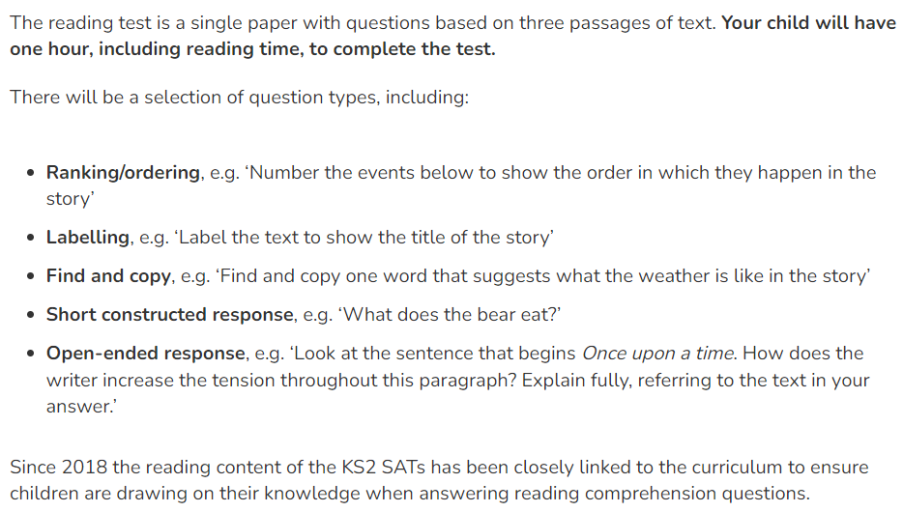
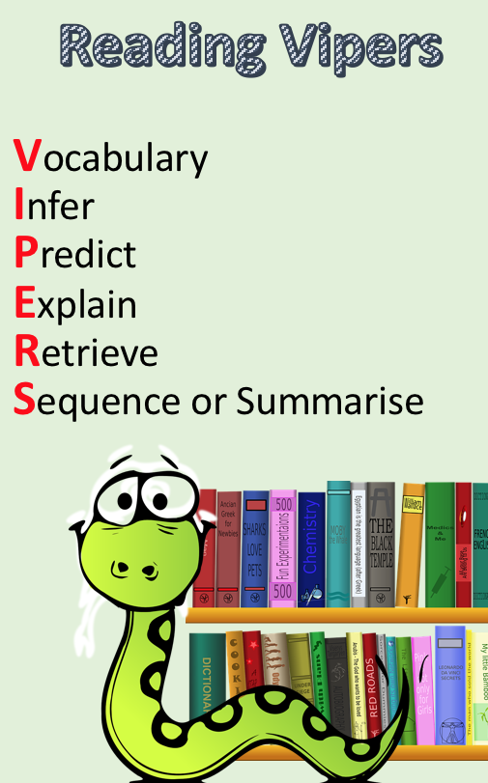
READING

Slide 9
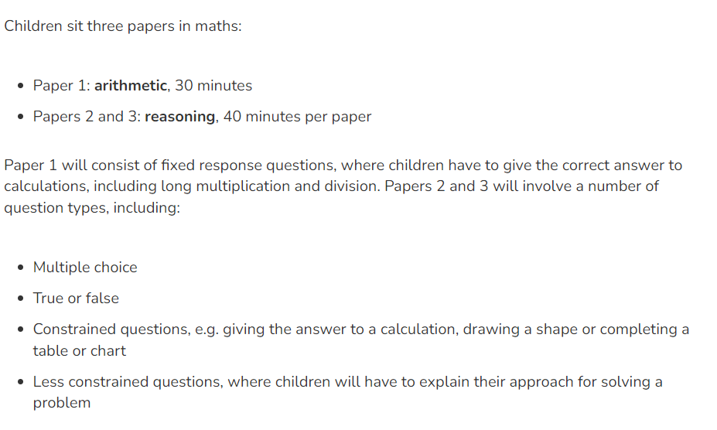
MATHS

Slide 10
Spellings
The Year 3/4 and Y5/6 national spelling are all on Google Classroom. Your child will be tested on these for their SATs. Please practise these at home.

Slide 11
Spelling strategies

Slide 12
Thank you!
for your continued support!

